Slide 1
NLP: Let the Machine Do the Reading
Introduction

Slide 2

What is NLP?
A field of linguistics
Focused on learning anything related to human language
The goal is to understand words and their context
One of the most exciting fields in AI and has already given rise to technologies like chatbots, voice assistants, translators, and many other tools we use every day

Slide 3
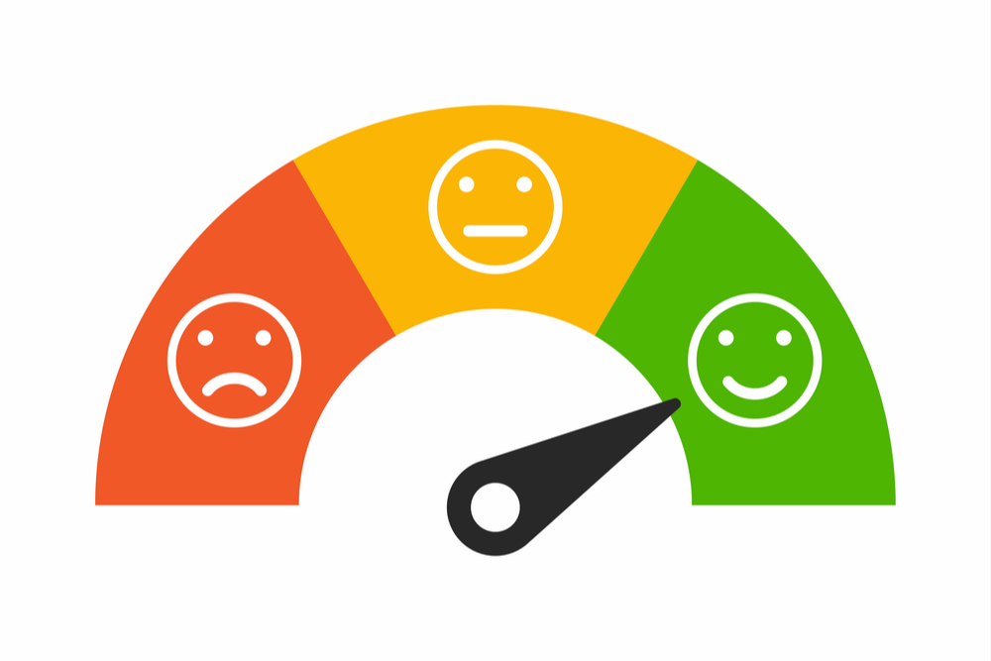
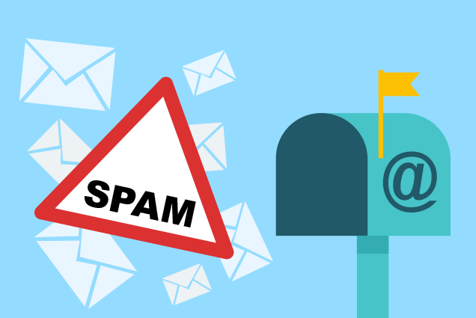
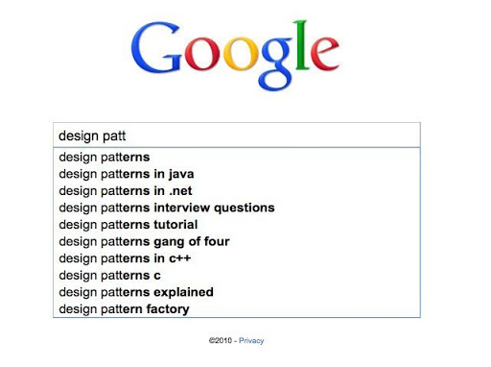
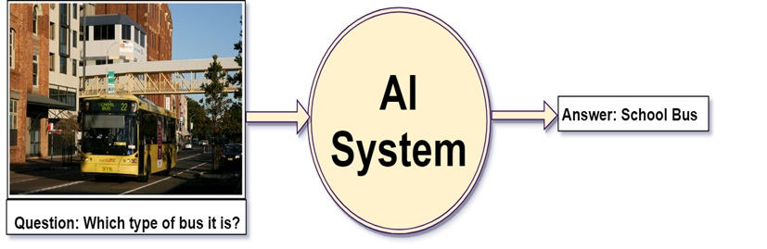
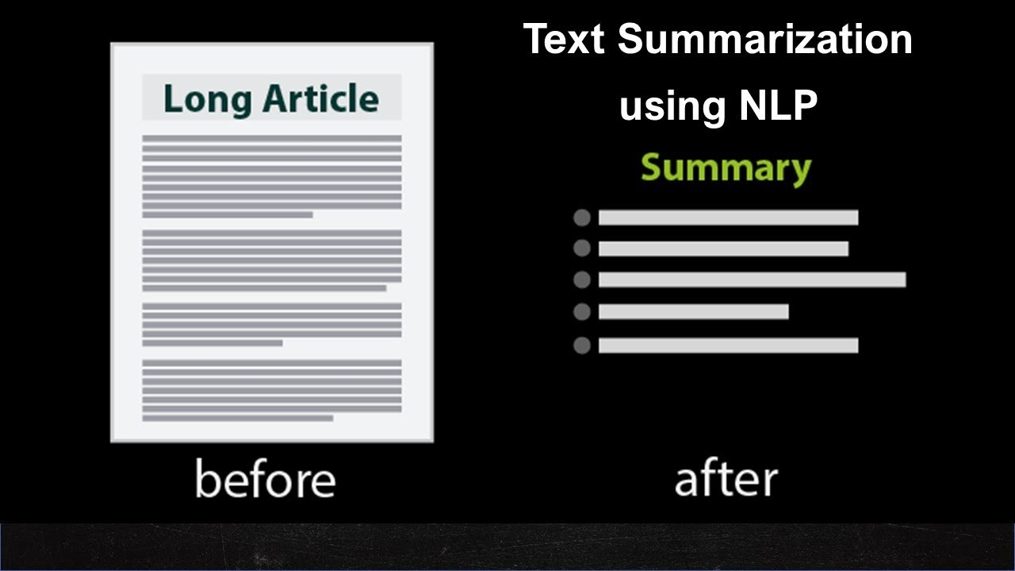

Common NLP tasks
Sentiment analysis
Spam detection
Autocompletion
Question answering
Translation
Summarization
Generate transcript of an audio
Generate description of an image

Slide 4
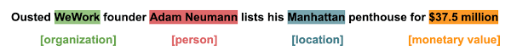
The Challenge
Computers aren’t humans
We can easily understand the meaning of “I’m hungry”, or if two sentences are similar or not, but computers can’t
The text needs to be processed in a way that will enable the ML model to learn from it
There has been a lot of research done on how to represent text

Slide 5
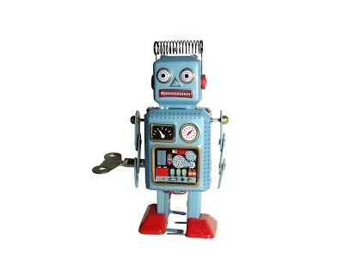
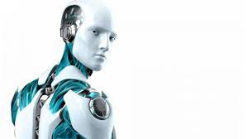
A little Bit of History
1950’s - early 1990’s
Rule-based and/or dictionary lookup: translation, chatterbots..
1990’s - 2010’s
More complex algorithms and the introduction of machine learning algorithms for language processing
More research into methods of more effective learning from limited amounts of data
Unsupervised and semi-supervised learning algorithms
2010’s - Present
Abandoning statistical methods
Widespread of deep neural network-style machine learning methods
Achieving state-of-the-art (SOTA) results in many language tasks

Slide 6
NLP Latest Trends and Techniques
Transfer learning
Transformers based models (i.e. BERT) will lead the way
Low-code tools going mainstream, i.e. Pytorch, Trax
Multilingual NLP will grow
Combining supervised and unsupervised machine learning methods
Automating customer service: tagging tickets, new era of chatbots
NLP for social media monitoring
Detecting fake news and cyber-bullying

Slide 7

Why NLP?
It is a huge field
Most of the technology around us uses NLP models
There are billions of text data being generated every day
Highly unstructured data sources
We no longer can handle large volumes of data without using ML and NLP

Slide 8

Limitation and Challenges
Contextual words and phrases and homonyms, i.e.
“I ran to the store because we ran out of milk.”
“Can I run something past you real quick?”
“The house is looking really run down.”
Irony and sarcasm, i.e.
Domain-specific language, i.e.
healthcare vs. legal documents
Need to quantify bias in NLP, i.e.
“Man is to doctor as woman is to nurse”

